Slide 1

HOTDOG.py
Playfully created by Vallie E Tracy

Slide 2
PROCESS Coming up with an idea
Immediately dove in
== no pseudocode!
Positives:
started to see some things I wanted to focus on
got creative juices flowing
Dialed it back
wrote pseudocode

Slide 3
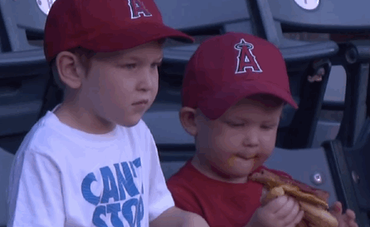
Minimum Viable Product:
3 MAIN SECTIONS
1.) Introductory conversation function
-focused on strings
2.) Driving Directions function
-integers, appending list
-calling another function that focused on equations
3.) Ending grocery shopping function
-build a dictionary of key:value pairs made of strings and floats

Slide 4

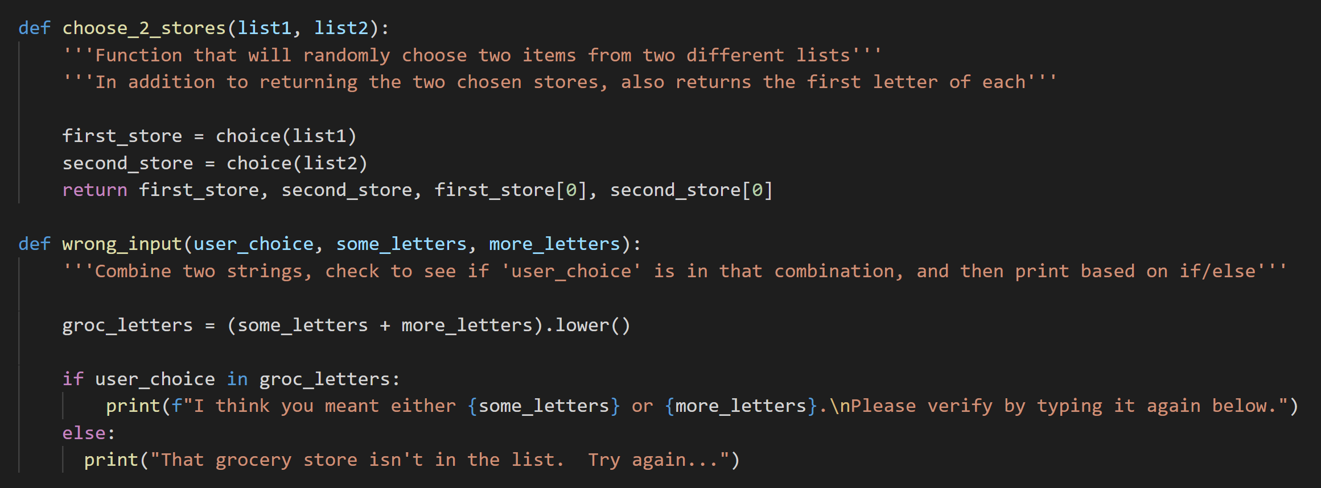
What it made me think about

Slide 5

Challenges
Refactoring code as the code got longer and more complex
Pseudocode is helpful!
Storing function output to call elsewhere

Slide 6

DEMO TIME!

